Slide 1
THE BATTLE OF NEIGHBORHOODS: SETTING UP YOGA STUDIOS IN DOWNTOWN TORONTO
DOVLATOVA SARIYYA
IBM APPLIED DATA SCIENCE 14.05.2021

Slide 2
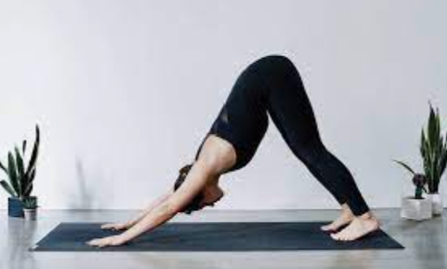
Background: health lifestyle trend
A healthy lifestyle is one of the most important trends for a modern person. It involves a balanced diet and physical exercise aimed at strengthening health.
Sport venues industry is one of the most developing and popular.
One of the perspective directions is yoga studios. Multiple health benefits related to yoga, celebrity endorsement & promotion of yogic practices drive the growth of the global yoga market.
As it is known, a majority of people practicing yoga are vegetarian, as this is one of the principles of yoga (Principle of ethical attitude to the world and of avoiding violence)

Slide 3
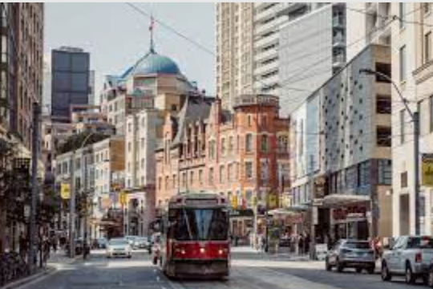
DOWNTOWN TORONTO
Downtown Toronto is a dynamically developing area with a huge potential, due to the fact that a large number of people who monitor their health and wish to live a healthy lifestyle live, work, and study there.
Downtown Toronto is the main central business district of Toronto, Ontario, Canada. Located entirely within the district of Old Toronto, it is approximately 17 square kilometres in area.
Historical sites and landmarks include the Arts & Letter Club, the Church of the Holy Trinity, Mackenzie House, Maple Leaf Gardens, Old City Hall, and the Toronto Police Museum and Discovery Centre.

Slide 4
Business problem description
1. Which neighborhoods of Downtown Toronto are the best for opening yoga studios?
2. Which neighborhoods venues can affect decision making?

Slide 5
DATA
List of neighborhoods of Downtown Toronto
retrieve the URL from wikipedia:
https://en.wikipedia.org/wiki/List_of_postal_codes_of_Canada:_M
Geographical coordinates of neighborhoods locations
geopy.geocoders from GeoPy library in python
List of all venues located in above neighborhoods
Foursquare API data provider

Slide 6
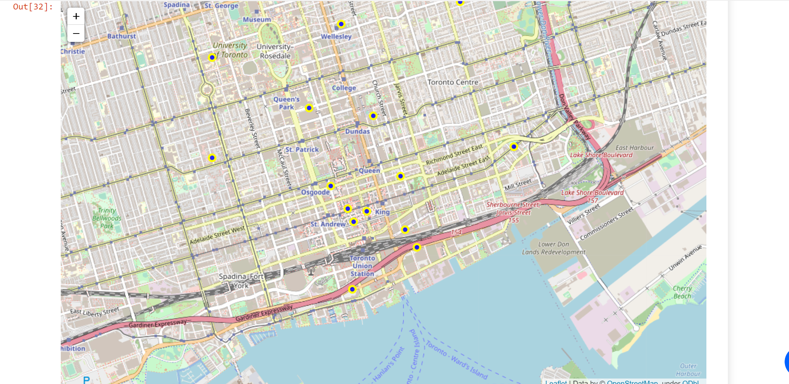
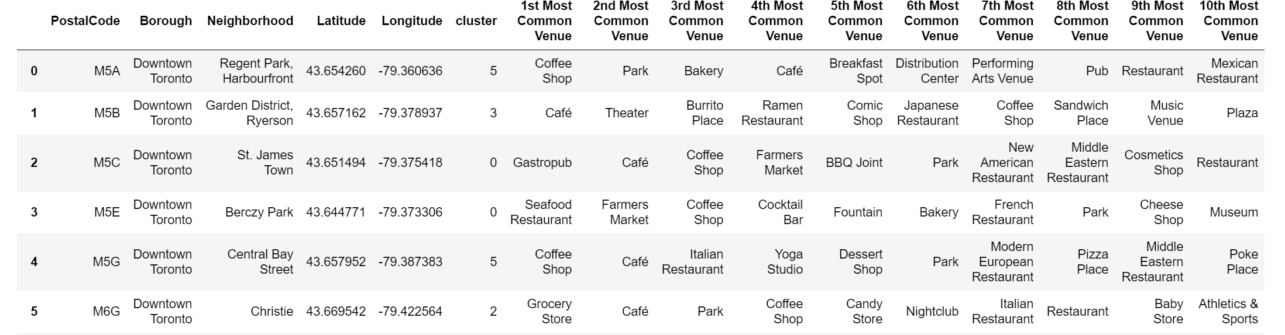
Methodology
Explore neighborhoods of Downtown Toronto
One Hot encoding, k-mean clustering using sklearn library
Analyzing already existed sporting venues and vegan restaurants
Visualizing them using folium library.

Slide 7
Resuts
It still lacks yoga studios in comparison to other sporting venues in neighborhoods of Downtown Toronto and opening them is seen as profitable.
location of new yoga studios near the vegetarian restaurants will allow us to attract their visitors as potential clients of yoga studios
After after analyzing neighborhoods we define 2 appropriate locations such as Richmond and First Canadian Place as first candidates for opening yoga studios.

Slide 8
Discussions
Many other factors such as
size of community in each neighborhood,
land price,
transport availability,
legislation requirement and etc.
should be analyzed for decision making process.

Slide 9
Conclusions
Machine learning techniques and algorithms help us process big data sets comprehensively and allow to make correct business decisions in a short time.
Python libraries such as sklearn for clustering and modeling process, geospy for finding geographical coordinates.
Folium library for visualization data location and applying Foursqare API make process easy and effective for analyzing and decision making process.

